Slide 1

Student Performance Dashboard
Presented by: Ahmed Tayel, Mehrael Sawiris, Nora Mohamed, Mohammed Eslam Mohammed, Abdulrahman Eid, Hamza Yasser Mohamed
Date: Nov 15, 2025

Slide 2
Project Idea:
This project aims to develop a comprehensive data engineering and analytics system to manage, analyze, and predict student academic performance. It integrates data from multiple sources such as grades, attendance, engagement, and socio-economic factors into a centralized Data Warehouse.
Data Collection & Storage
Data Management
Interactive Dashboards
Efficient data collection, cleaning, and storage using Python and ETL tools like SSIS.
Structured data management with relational databases designed from ER diagrams.
Interactive dashboards to visualize student trends and behavior.
Predictive Models
Modern Architectures
Development of predictive machine learning models to identify students at risk and estimate academic outcomes like GPA.
Exploration and practice with modern data architectures like Data Lakes for flexible handling of raw data.
The system is designed to provide actionable insights to educators and decision-makers, supporting targeted improving student success.

Slide 3
Data Flow :
1
2
3
Data Collection & Cleaning
Relational Database
ETL with SSIS
Refined data imported into a relational database, serving as primary structured storage.
SQL Server Integration Services automated loading cleaned data into the Data Warehouse.
Initial CSV data with diverse features cleaned using Python in Jupyter Notebook for consistency.
4
5
Data Warehouse & Lake
Dashboard Access
Consolidates data for complex querying and reporting; Data Lake stores raw, unstructured data for future analytics.
interactive dashboards for informed decisions.

Slide 4
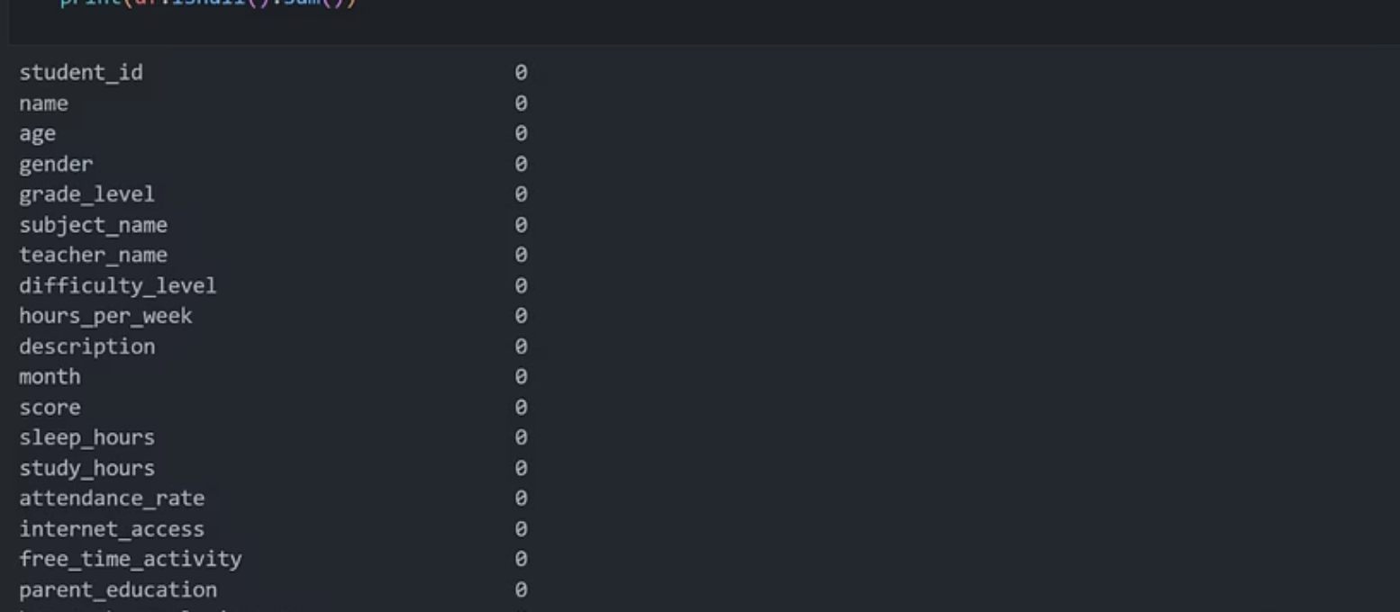
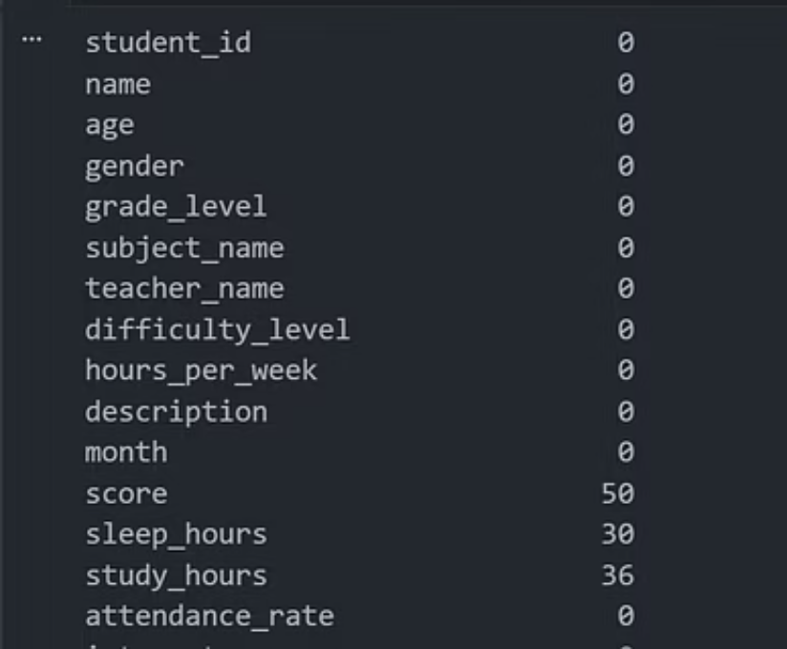
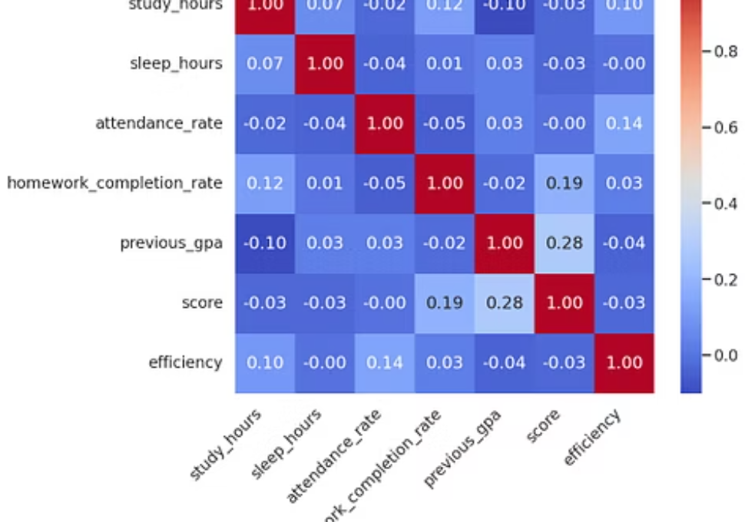
Data Cleaning and Visualization
We performed data cleaning using Python to handle missing values, remove duplicates, and normalize data for accurate analysis and modeling.
For visualization, we utilized popular Python libraries Matplotlib and Seaborn to create effective and insightful charts.
These tools helped us explore the data distribution, relationships, and trends visually, aiding in better understanding and communication of the data insights.

Slide 5
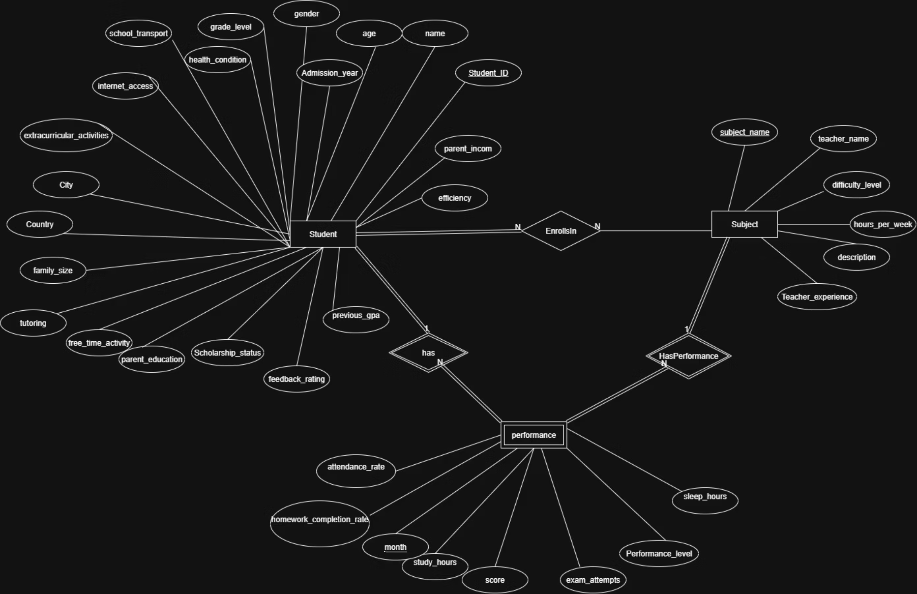
Entity Relationship Diagram (ERD)
This ERD visualizes our student performance database structure, showing how entities like Student, Subject, Teacher, and Grades are interconnected. The diagram maps each entity to database tables with proper relationships, constraints, and cardinality to ensure data integrity and efficient analysis.

Slide 6
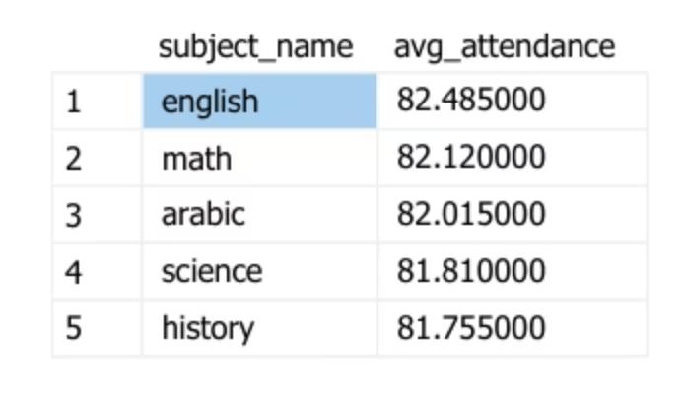
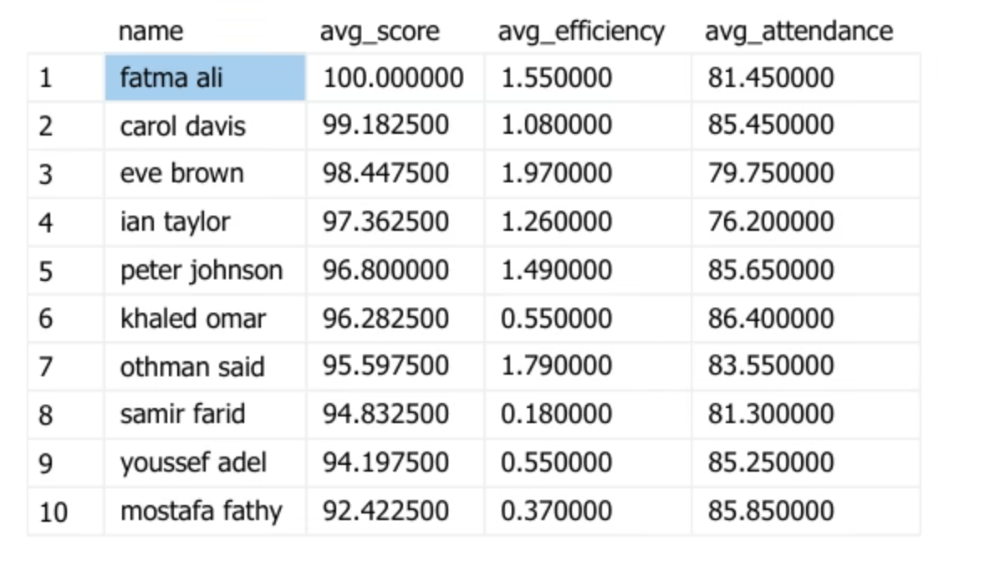
Database and SQL Integration
Designed and implemented a relational database structure based on the Entity Relationship Diagram (ERD) to efficiently manage student and academic data.
Leveraged SQL for database creation, querying, and management to maintain data integrity and support complex analytics.

Slide 7
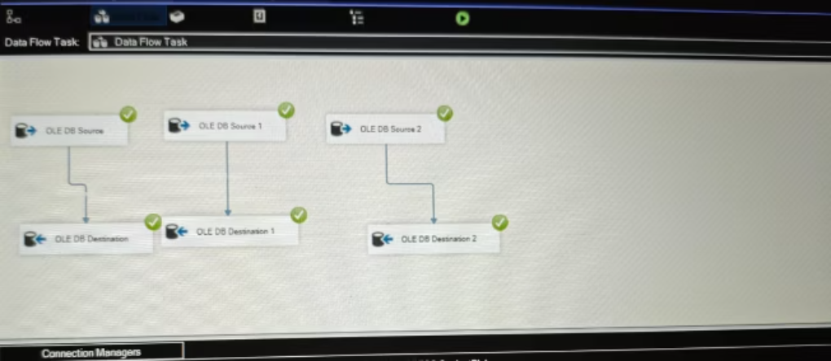
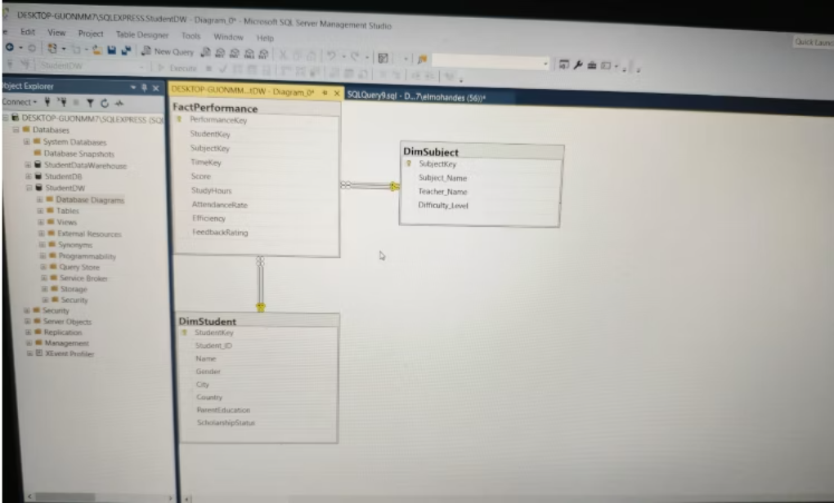
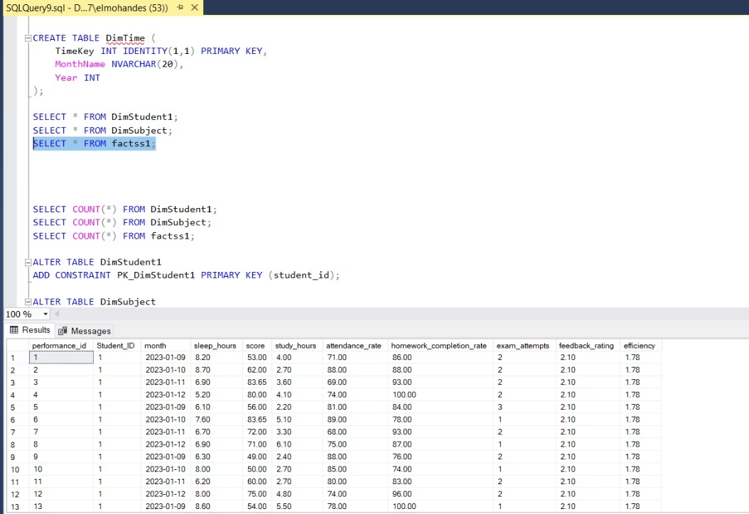
Data Warehouse
The Data Warehouse is a centralized repository that stores integrated, cleaned, and structured data from multiple sources. Using SSIS (SQL Server Integration Services), we extract, transform, and load data efficiently into the warehouse. The data is organized into fact tables that store key performance metrics and dimension tables that provide descriptive context. This architecture supports fast querying, accurate reporting, and advanced analytics, enabling data-driven decisions and deeper organizational insights.

Slide 8
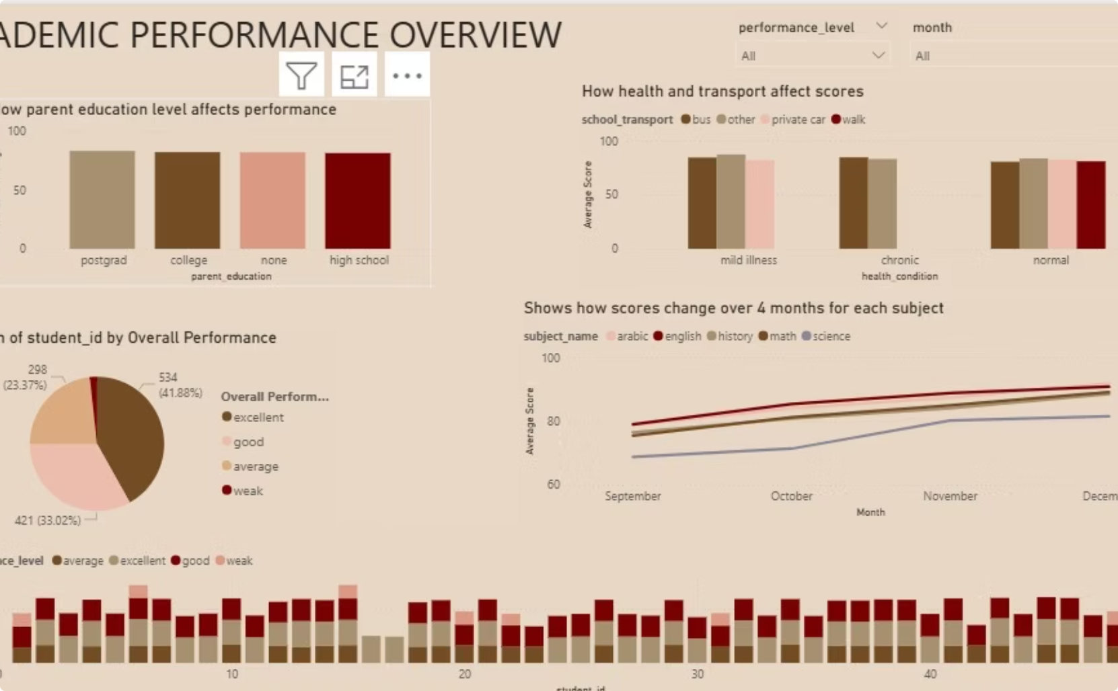
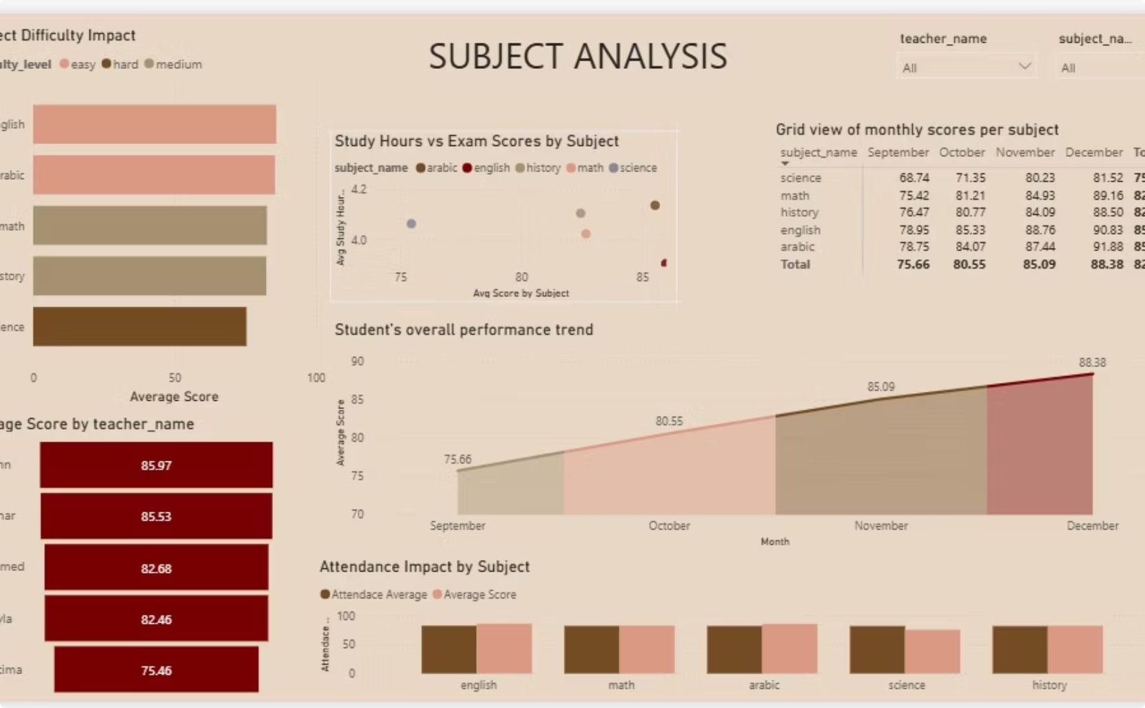
Dashboard Development
Dashboards were created to visualize student metrics such as attendance, grades, and performance trends over time. Interactive charts and reports help identify high-performing students, detect patterns, and support data-driven interventions.
Academic Performance Overview
Subject Analysis Dashboard

Slide 9
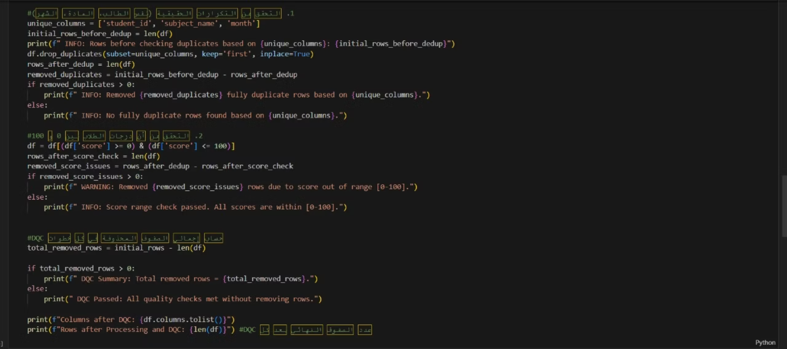
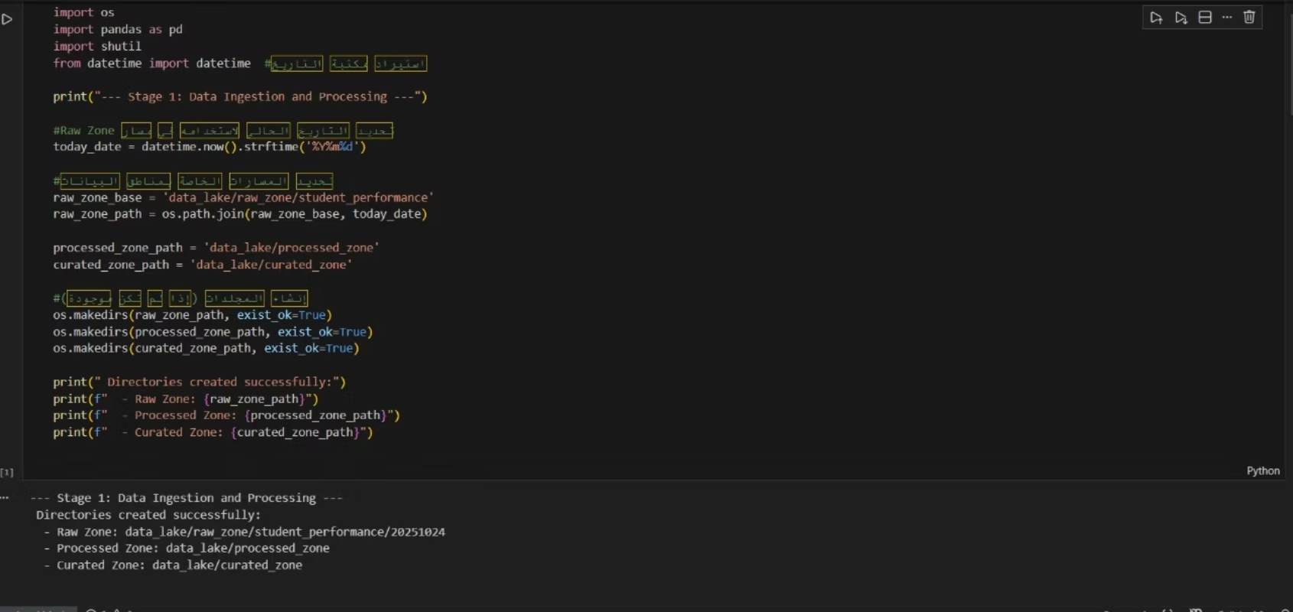
Data Lake:
A Data Lake is a large, centralized storage system that holds raw data in its native format.
It can store structured, semi-structured, and unstructured data such as logs, images, videos, and sensor data.
The Data Lake allows us to ingest data at high volume and speed without requiring immediate processing.
It supports advanced analytics, machine learning, and data exploration by providing flexible access to raw datasets.
The Data Lake works alongside the Data Warehouse to provide both detailed raw data and clean structured data for different analytical needs.

Slide 10

Project Team & Roles
Ahmed Tayel
Mehrael Sawiris
Nora Mohamed
Data Collection & Cleaning, Data Visualization
ERD & Dashboard Design
Machine Learning & Database Management
Mohammed Eslam Mohammed & Hamza Yasser Mohamed
Abdulrahman Eid
Data Lake Implementation
Data Warehouse Development

Slide 11
Programming Languages & Frameworks
Python
SQL Server
For data cleaning, analysis, and scripting.
For database management and SSIS ETL.
Jupyter Notebook
Power BI Tool
For interactive data exploration and cleaning.
For interactive dashboards and reporting.
SSIS
For ETL Pipeline

Slide 12

Thank You!
We appreciate your time and attention. Please feel free to ask any questions.

